Slide 1
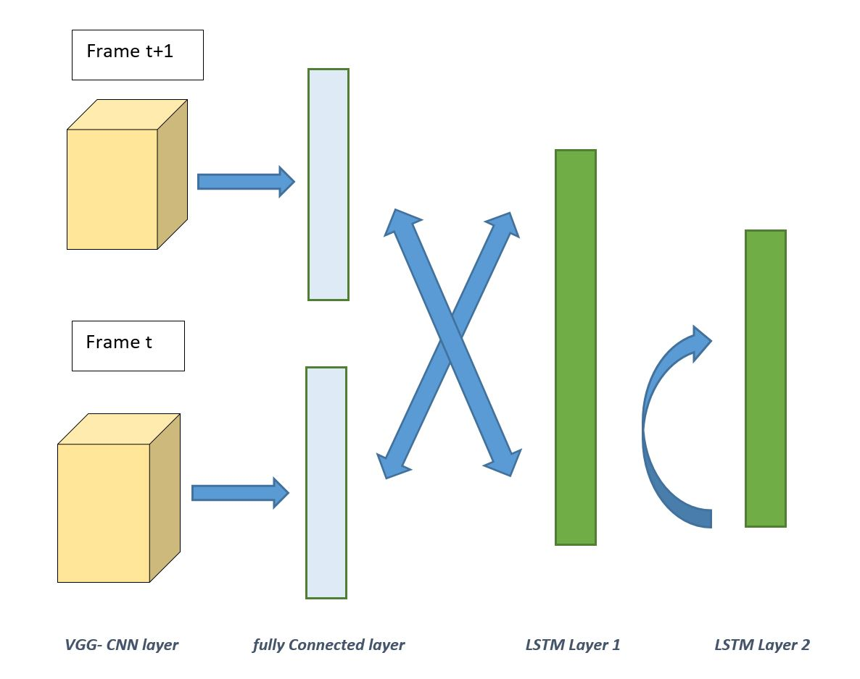
Visual Tracking using CNN-RNN
Authors: Bharath C Renjith, Janani Kalaivani,
Rajaram Sivaramakrishnan
Course Number: ECE 542-001
Team ID: 542-09
Motivation and Goals
Instructor: Edgar Lobaton
In this project, we implemented a visual tracker using Recurrent Neural Networks (RNN) and Convolutional Neural Networks(CNN). Our network will be trained from annotated video dataset and generates a
bounding box across frames over the tracked object in the video. The motivation behind this project is to design visual tracking network without utilizing pre-trained classifier models, like Haar. While Haar is useful for object detection, it is inefficient due to its primitive capabilities. The goal of this project is to teach the network, how any given object is likely to change over time so these transformations can be embedded directly into the network.
Methodology and Results
Visual tracking, also called object tracking, refers to automatic estimation of the trajectory of an object as it moves around in a video. Although existing computer vision techniques may offer satisfactory solutions to this problem under well-controlled environments, the problem can be very challenging in many practical applications due to factors such as partial occlusion, cluttered background, fast and abrupt motion, dramatic illumination changes, and large variations in viewpoint and pose.
The architecture consist of CNN layer that is structured by
VGG16 network and connected to LSTM network. The
Understanding is that the CNN focuses on detecting the
Object of interest while the LSTM stiches the frames into a
continuous tracking.
Fig 1: CNN-LSTM architecuture
Conclusion and Extensions
Reference
[1] Jia Zhang, Lei Yang and Xiaoyu Wu, "A survey on visual tracking via convolutional neural networks," 2016 2nd IEEE International Conference on Computer and Communications (ICCC), Chengdu, 2016, pp. 474-479. doi: 10.1109/CompComm.2016.7924746
[2] Y. Wu, J. Lim and M. Yang, "Online Object Tracking: A Benchmark," 2013 IEEE Conference on Computer Vision and Pattern Recognition, Portland, OR, 2013, pp. 2411-2418.
doi: 10.1109/CVPR.2013.312

